Slide 2



PPrun and PPtrans
Slide Show Automation
Voice Over Generator
Voice Over Translator
for

Slide 3
Tools
PPrun is a command-line utility that can be used for the following tasks:
Scripted execution of a PowerPoint presentation (clicks and delays)
Speaking text out loud included in the script (voice over)
PPtrans is a command-line utility that translates the voice-over texts contained in the presentation script and/or texts in the PowerPoint presentation itself.

Slide 4
Design
Microsoft Office Automation
PPrun makes use of application automation using the component object model interface (COM). It reads the presentation script by automating Excel and controls the presentation by automating PowerPoint.
Google Cloud APIs
PPrun generates speech from text using the Google Cloud Voice API.
PPtrans translates text using the Google Cloud Translate API.

Slide 5
Prerequisites
In order to run the tools you must have the following installed:
Microsoft .NET 8 runtime
Microsoft Office 365
Google Cloud Console
Hardware Screen Recorder
Dual Monitor Setup
Video Editor Software
A Google account is required for calling the Google APIs. The PPrun and PPtrans apps use the local ADC file for this purpose (Application Default Credentials) created with the Google Cloud Console. This is all very well documented on the Google Cloud website.

Slide 6
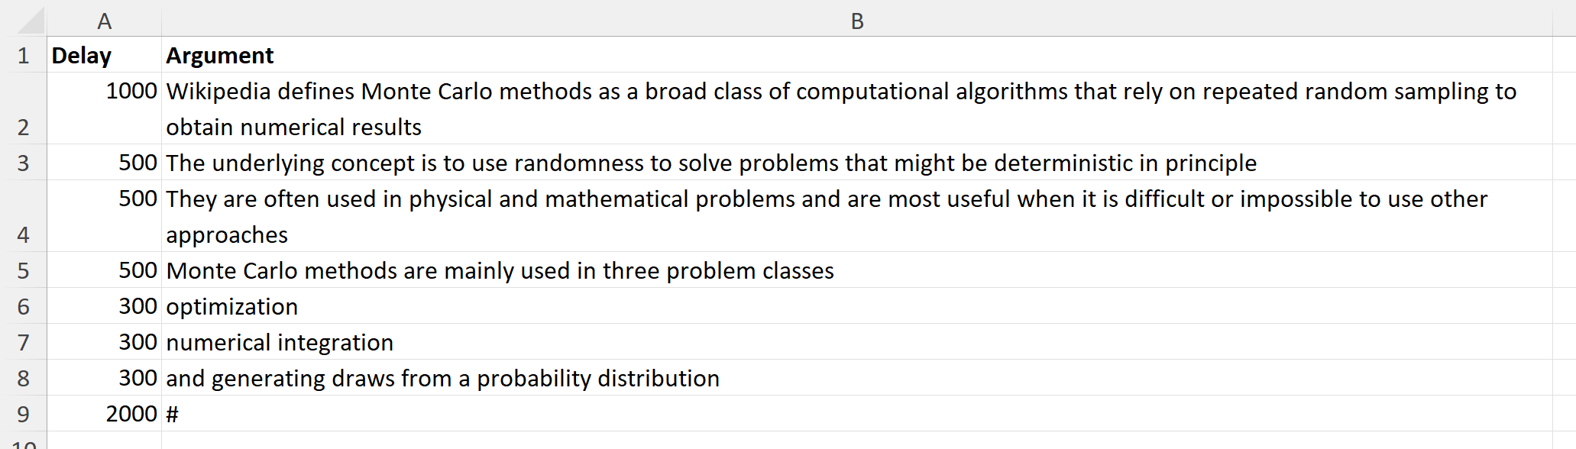
Excel Script File: Slides
The script for each slide is stored in a separate worksheet. Each sheet contains two columns. The Delay column contains a pause in milliseconds before executing the command stored in the Argument column. The argument column can contain a text to be spoken or a command.
# = Click @ = Pause ~ = Stop Text = Speak

Slide 7
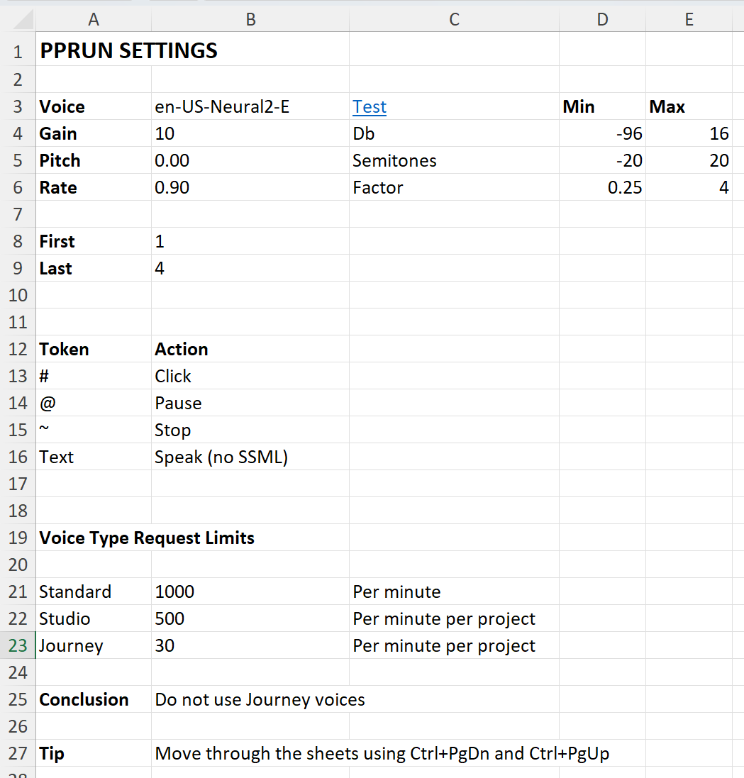
Excel Script File: Settings
The Google AI voice for a specific language is selected in the Settings sheet. Here you can also specify the speech settings like Gain, Pitch and Rate.
You can also control which slides must be shown using the First and Last settings. These settings are typically used in the creation phase of the script.
Please note that Google supports 3 different classes of voices, all with different request limits. Avoid using the Journey class of voices because the request limit rate is simply too low for practical application.

Slide 8
Excel Script File: Execution
The Excel presentation script and the PowerPoint presentation must have the same name and should be in the same directory. Also copy the PPrun.exe file into this directory. You are all set if your folder contains the following three files.
Script : Demo.xlsx
Presentation : Demo.pptx
Tool : PPrun.exe
Open a command prompt in this folder and issue the following command assuming all files are contained in a directory called Work.
You will receive spoken instructions on how to continue. Pause the presentation with the spacebar or abort using the escape key. Make sure the console window has the focus when using these keys.

Slide 9


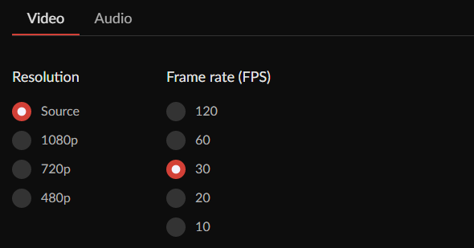
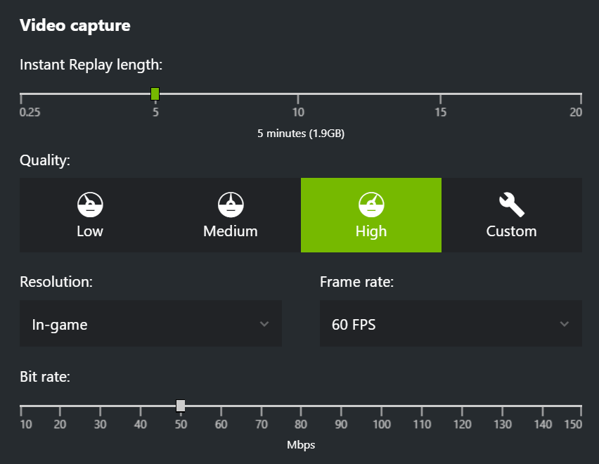
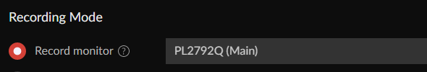
Screen Recording
You can record the screen using software like Overwolf or ShadowPlay that use the hardware of the graphics card (hardware acceleration).

Slide 10
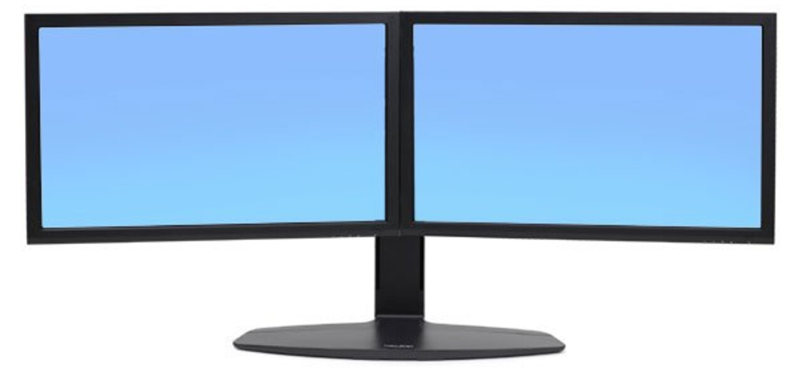
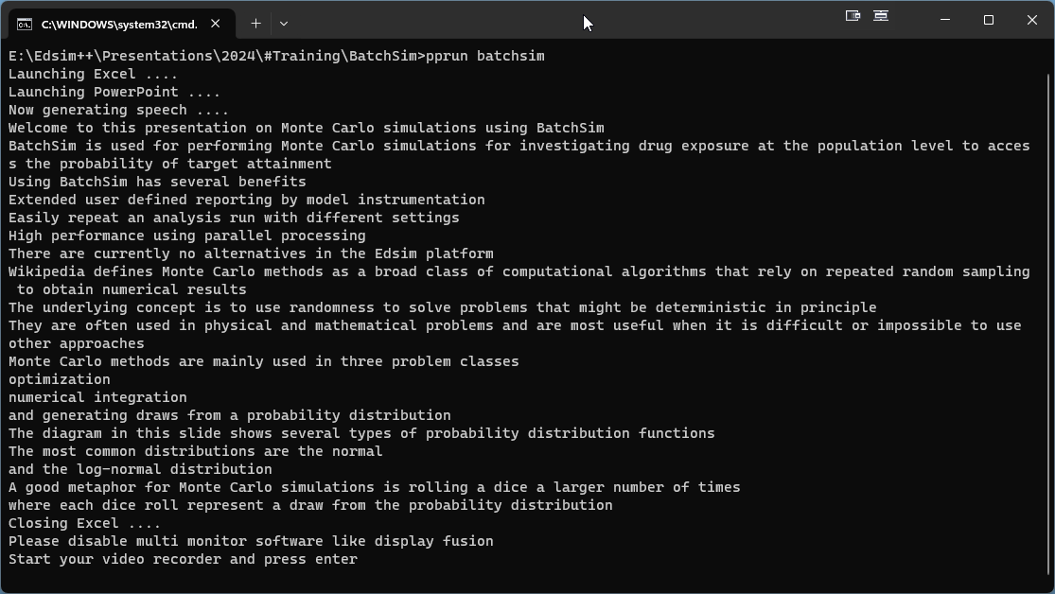
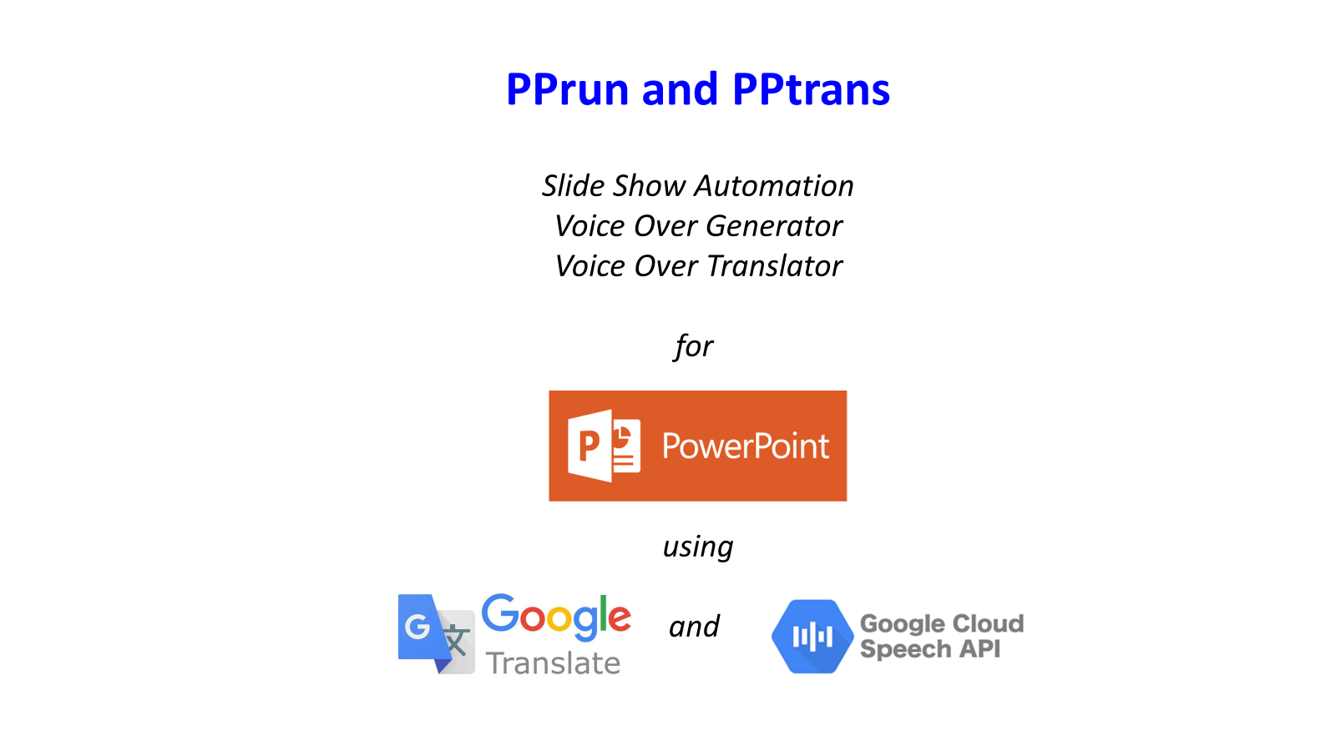
Dual Monitor Setup
A dual monitor setup is an absolute requirement for using PPrun. The tool will typically run on the left monitor and the presentation on the right monitor. Avoid the use of multi display software like Display Fusion because user interface elements of these applications may appear on the presentation screen.

Slide 11

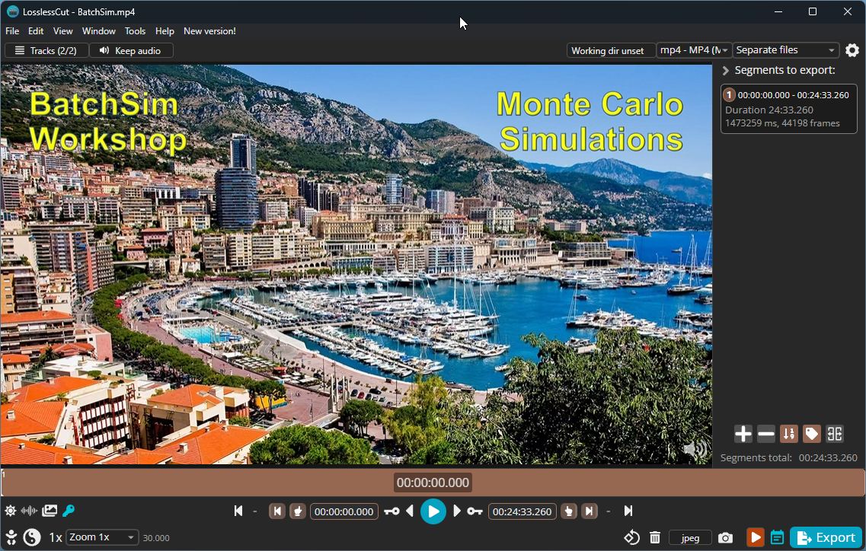
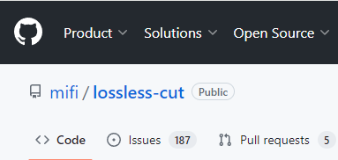
Trimming the Video
The video must be trimmed in order to remove unwanted recording at the start and the end. We recommend the LosslessCut open source video trimmer that avoids having to re-encode the whole video.
LossLessCut

Slide 12
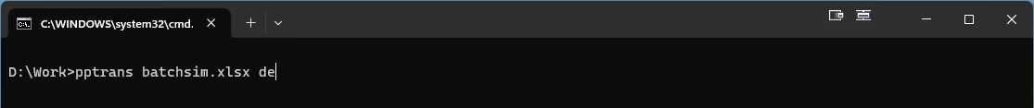
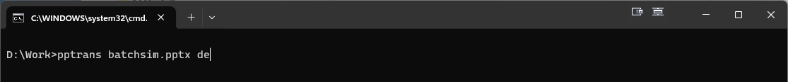
Translating the Presentation
The PPtrans tool can be used to translate the presentation script or the PowerPoint presentation itself.
Open a command prompt and issue the following command to translate the presentation script to German (de).
Issue the following command to translate the PowerPoint presentation to German (de). Some minor text formatting may be lost in the process.

Slide 13


Updating the Selected Voice
Do not forget to update the selected voice in the settings screen after translating the presentation script. Otherwise you would be hearing me speaking French with an American accent like in the next sentence.
N'oubliez pas de mettre à jour la voix sélectionnée dans l'écran des paramètres après avoir traduit le script de présentation. Sinon, vous m'entendrez parler français avec un accent américain comme dans la phrase suivante.

Slide 14
Known Issues
Automation of office application can be associated with the following problems:
Orphaned Excel or PowerPoint processes which require manual termination after a crash.
Automation errors caused by anti virus software.
Automation errors caused by PowerPoint Add-ins. We recommend to disable all Power-Point add-ins before running the tool.
Please note that ppRun creates a copy of the presentation in order to prevent corruption of the presentation file after a crash.

Slide 15
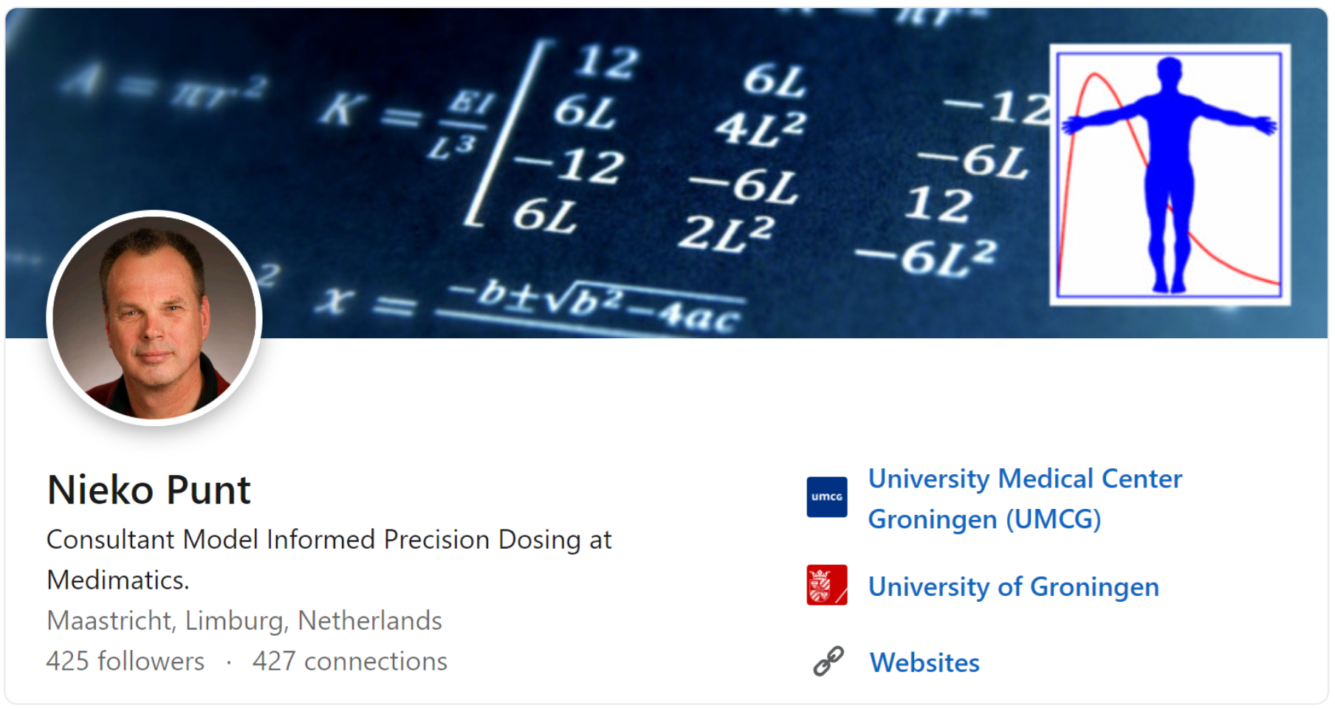

Slide 16




